Slide 1
Computer Application Designer

Slide 2

What do they do?
An application designer develops software based on the specific needs of a group of end-users. They determine what the target group's expectations are for a particular piece of software (such as mobile apps or computer games) and then create a development plan for the design of the software.
industry experience, and a bachelor's degree in a software- or computer-related field are typical requirements for this position.

Slide 3

Work Conditions
Application designers typically work on a team that may include other computer analysts, programmers and end-users.

Slide 4

Who Are The Customers
Computer application engineers design and produce commercially sold software suites, most design or customize applications for businesses or other organizations. Some application engineers design and analyze databases within a given application area.
Computer application designers work for big businesses and company’s that are involved in the app making process.

Slide 5

Salary?
The salary range for a computer designer can range anywhere from 69k annually to 100k annually. This depends on how effective one is in doing their job, the sonority of an employee and what company one works for as different company’s have different beliefs when it comes to pay day.

Slide 6

Job Numbers And Availability
According to the U.S. Bureau of Labor Statistics, software developers, who are often involved in the design of computer applications, are expected a 17% increase in employment opportunities from 2014-2024, this is a significant jump compared to all other careers across the nation. The software developers who work specifically on applications made an impressive annual wage of $98,260 as of May 2015 and has a projected job growth rate of 19%.

Slide 7
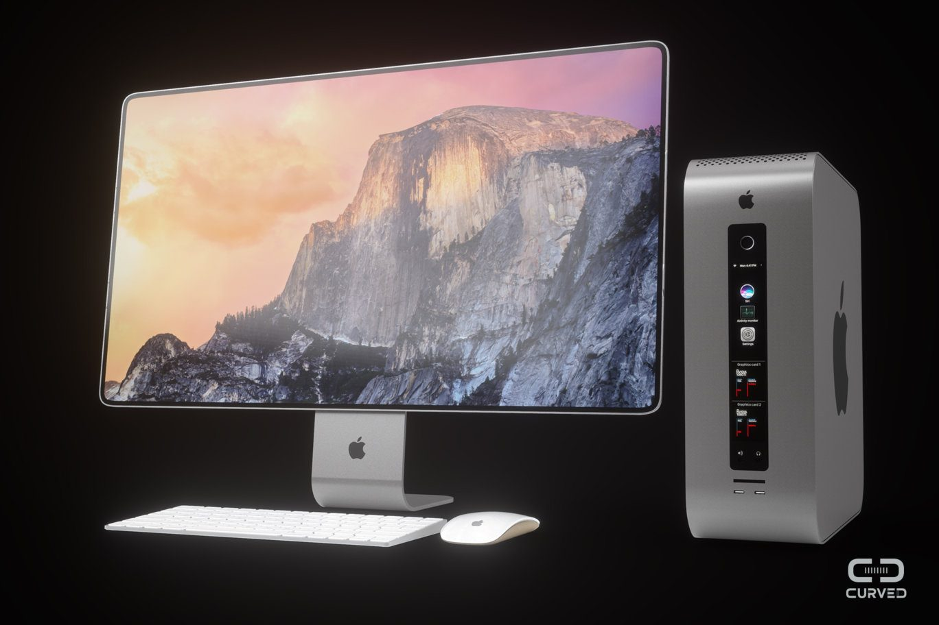
Type Of Computers
· HP Envy 34 Curved All-in-One
· Microsoft Surface Studio
· Apple iMac with 4K Retina display
· Apple iMac Pro
These are just a few of the many types of computers that are used when working in this industry. One thing that all of these computers have in common is that they all have very a big display screen and have an enormous amount of power. The average person would not need a computer this advanced but for computer application designers this is a good tool because it allows them to edit as they will and can hold a lot of data.

Slide 8
High School Credits Required
Some Ontario college computer applications programs are offered as entry level programs, meaning you only require an Ontario Secondary School Diploma (OSSD) or equivalent and any grade 12 English.
A bachelor's degree in computer science or in another discipline with a significant programming component or completion of a college program in computer science is usually required.
Specialization in programming for engineering and scientific applications requires specific post-secondary study or experience.

Slide 9

College Programs
Ontario Secondary School Diploma (OSSD)
Grade 12 English (ENG4U)
Grade 12 Advanced Functions (MHF4U)
Grade 12 Calculus and Vectors (MCV4U)
One other Grade 12 university-level course
Two additional Grade 12 university-level or university/college-level courses
Minimum Average
High 80s to Low 90s

